Slide 1
R, What is it good for?
Absolutely Everything
Jasmine Dumas
@jasdumas
Notes:
Title homage: https://www.youtube.com/watch?v=dpWmlRNfLck the song War by Edwin Starr

Slide 2
“Seriously, it’s good for everything”
–Me
Notes:
industry, academia & fun….everything

Slide 3

Good vs. Good
🔑
Notes:
Key Presentation takeaways: Much like “you all” and “y’all” mean the same thing, R is good, python is good, scala is good. Good does not mean great, but Good is better than bad. When we try to compare programming languages we tend to look at the surface components (popular developer influence or singular use cases or language development & design choices) and sometimes we forget the substantive (sometimes secondary) components of what can make a programming language appropriate for use, such as: versatility, environment and inclusivity (and a strongly opinionated take).
I’ll highlight each of these themes in the presentation to show and not tell of why R is good for everything!

Slide 4

Hi Austin!
Data Scientist @ Simple Finance
Author of R packages: ttbbeer, shinyLP, gramr, shinyGEO
Slides and Materials available on GitHub: jasdumas/talks/r-data-day-texas

Slide 5
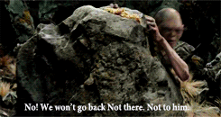
What is this talk about?
Notes:
This talk is about highlighting the practical, real and precious ways that R is useful and good for everything. The Real Gollum is tangible, mischievous, purposeful …

Slide 6

What is this talk not about?
Notes:
… directly antithetical to James Franco’s Fake Gollum: This talk is not about R vs. Python vs. Julia vs. Java vs. Cobol vs. Scala vs. Matlab vs. SAS….wait R is much better than SAS, but that’s another debate for another time over beers. No hyped up topics just pure facts & opinions :)

Slide 7
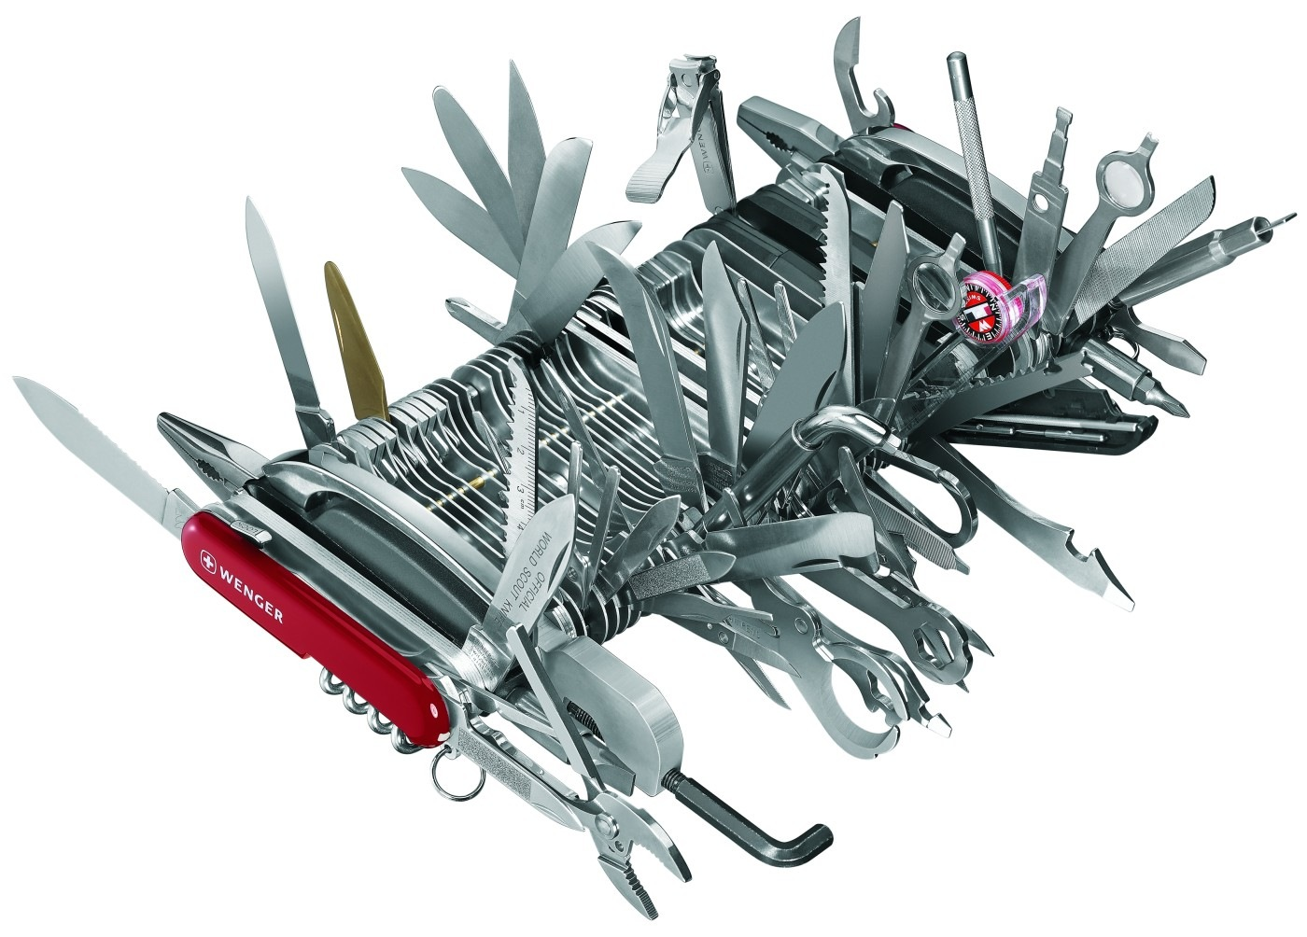
Versatility
Notes:
I’m going to show examples of how R is versatile with some cool projects from different domains and objectives:
bathroom tiles
turkey chart
gene expression
map of GOT

Slide 8
Bathroom Tile Design
ggplot2, dplyr, data.table, magrittr
Notes:
https://edwinth.github.io/blog/bathroom-with-r/
this was created by Edwin Thoen on his blog: That’s so Random which outlines how he choose to decorate his bathroom with a random tile design, rather than the mundane, ugly showroom examples he was presented with
this really emphasizes how many components of our daily lives have a computational approach and could benefit from using R to solve those problems

Slide 9
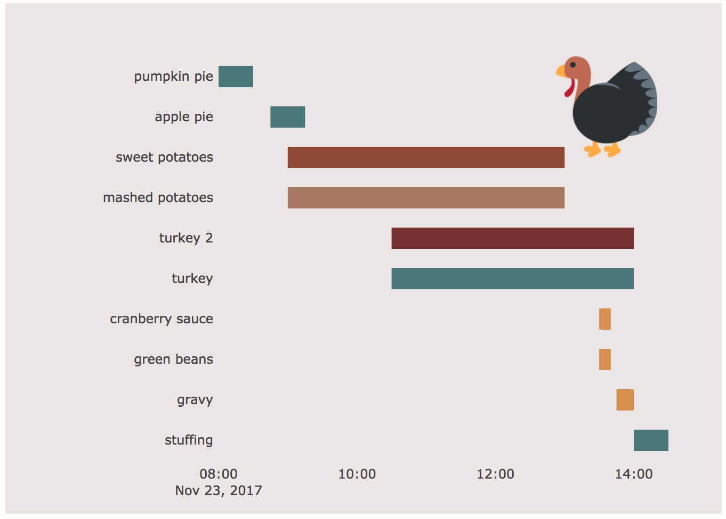
Thanksgiving Gantt Chart
googlesheets, lubridate, plotly
Notes:
http://livefreeordichotomize.com/2017/11/12/thanksgiving-gantt-chart/
this was created by Lucy D'Agostino McGowan who is also speaking today (actually right now) on the 2nd Floor - Amphitheatre 204
Really interesting approach to visualizing a common problem on Thanksgiving with multiple dishes using a few R packages

Slide 10
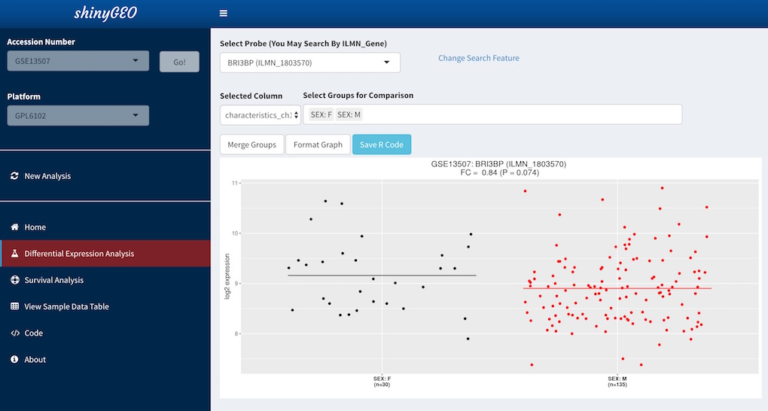
Gene Expression
shiny, ggplot2, survival, shinyjs
Notes:
https://gdancik.github.io/bioinformatics/
this was co-developed by myself, during Google Summer of Code as a web application to enable Bioinformaticians to perform differential expression on survival analysis with ease
shiny as a web framework has empowered those with statistical know-how and limited Frontend skills to create interactive analyses

Slide 11
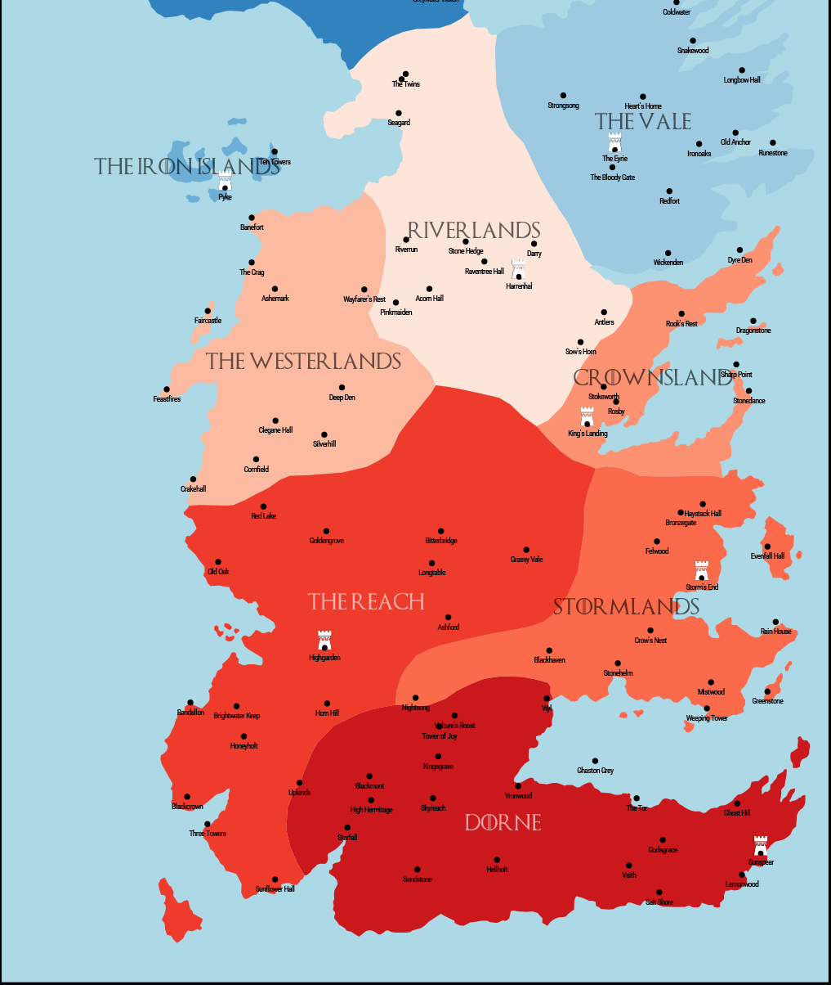
Map of Westeros
Hmisc, rgdal, tmap, RColorBrewer
Notes:
https://www.gokhanciflikli.com/post/game-of-thrones/
this was made by Gokhan Ciflikli, originally as a Quantitative Text Analysis to mine the scripts of GOT however things get more fun when a shapefile for Westeros exists form the Cartographers’ Guild website
Wide range of GIS and mapping packages for fictional and real maps

Slide 12
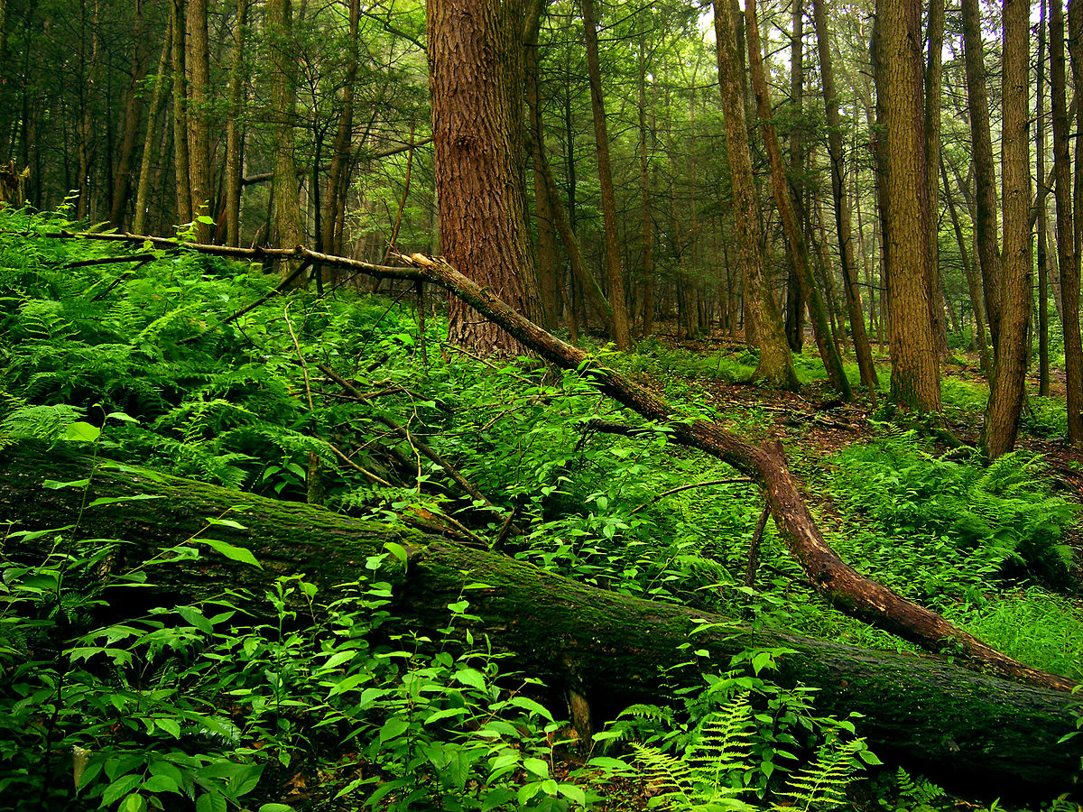
Environment
Notes:
Examples of how R is more than an language but also an environment which makes it good for everything.

Slide 13

Fully planned and coherent system
Notes:
https://www.r-project.org/about.html
The term “environment” is intended to describe R as a fully planned and coherent system, rather than an incremental concoction of overly specific and inflexible tools, as is frequently the case with other data analysis software, ala pandas for python.
And by planned and coherent, I’m really speaking to:
- R being focused on statistical techniques, data manipulation, calculations and graphical displays.

Slide 14

Storage
ff, bigmemory, data.table
Notes:
R being memory bound is a frequent (and often contentious) discussion point in our ever expanding world for Big data, however most of your data needs (Small, medium, big data) can be addressed with R using a variety of packages developed to take advantage of parallel computing [multi-threading]. Some of those packages are: ff, bigmemory, data.table, xgboost, Rcpp or rJava.
R can also handle different data formats (csv, json, spss, sas, text, proprietary excel …)
https://jasdumas.github.io/tech-short-papers/Reading_large_datasets.html

Slide 15

Calculations
Familiar binary and logical operators
Notes:
https://www.statmethods.net/management/operators.html
R has a suite of operators for calculations on arrays, and matrices which lends itself really well to R’s vectorized nature.
There are also some handy pipe themed operators: %>%, %<>%, :%in% to reduce code clutter and allow for nice integration with the tidyverse suite of packages.

Slide 16

Data Analysis Tools
tidyverse, bioconductor, tidyquant
Notes:
R has a large, coherent, integrated collection of intermediate tools for data analysis, made possible by extension of R’s base capabilities via packages on CRAN or GitHub.
Some of the packages include: tidyverse, dplyr, data.table, string (string manipulation), lubridate (date/time manipulation), sf (GIS/Spatial data), bioconductor (Bioinformatics), tidyquant (Financial), Environmental, Surveys…and many more.

Slide 17

Graphs
ggplot2, plotly, htmlwidgets
Notes:
R has graphical facilities for data analysis and display either on-screen or on hardcopy (Publication-ready and interactive). This is one of my favorite aspects of the R environment because even out-the-box with base R, you are on your way to creating data visualizations that illuminate large data sets.
R is also great for interactive graphics through packages such as: plotly and htmlwidgets
pretty graphs FTW! ggplot2! plotly! htmlwidgets!

Slide 18
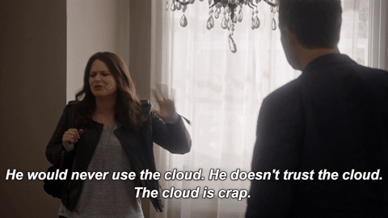
Virtual Environments
R + Docker, packrat
Notes:
Like you know and are use to with python. R has capabilities to work nicely with supporting cloud based computation (data storage on AWS) as to enable repeatable and portable analyses across machines.
R in the cloud: https://hub.docker.com/u/rocker/
https://www.andrewheiss.com/blog/2017/04/27/super-basic-practical-guide-to-docker-and-rstudio/

Slide 19
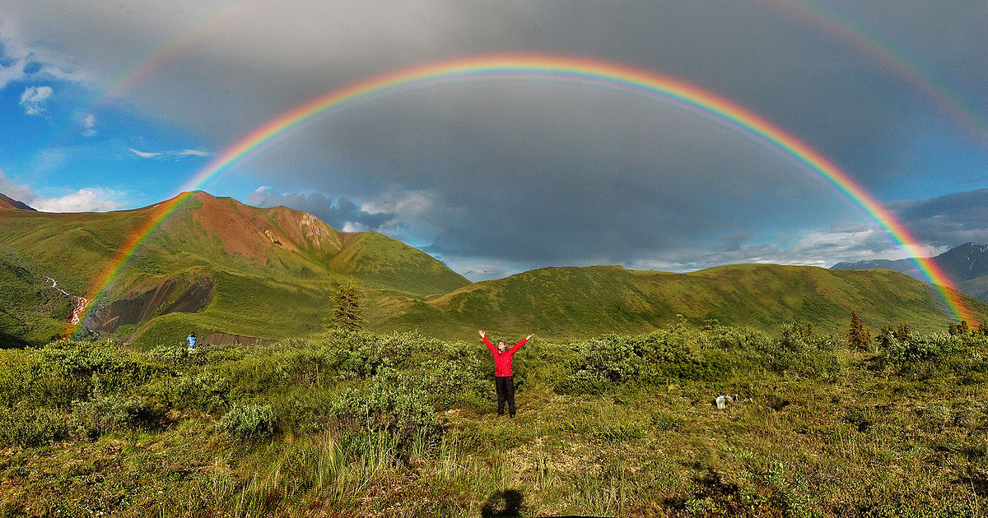
Inclusivity
Notes:
I’m going to speak to examples of how R is inclusive, welcoming, and diverse which goes to increase R’s position as being good for everything. This theme is not always at the forefront of new developers thoughts when first selecting programming languages to learn but is proving to be a high indicator of community maturity.

Slide 20
Forwards
http://forwards.github.io/
Notes:
The Forwards is a Taskforce established by the R Foundation in 2015 to address the underrepresentation of groups such as LGBT, minority ethnic groups, and people with disabilities in the R community.
There a sub teams within the Forwards task group which focus on: community, conference, new useRs, Social media, surveys, and teaching
http://forwards.github.io/about/

Slide 21
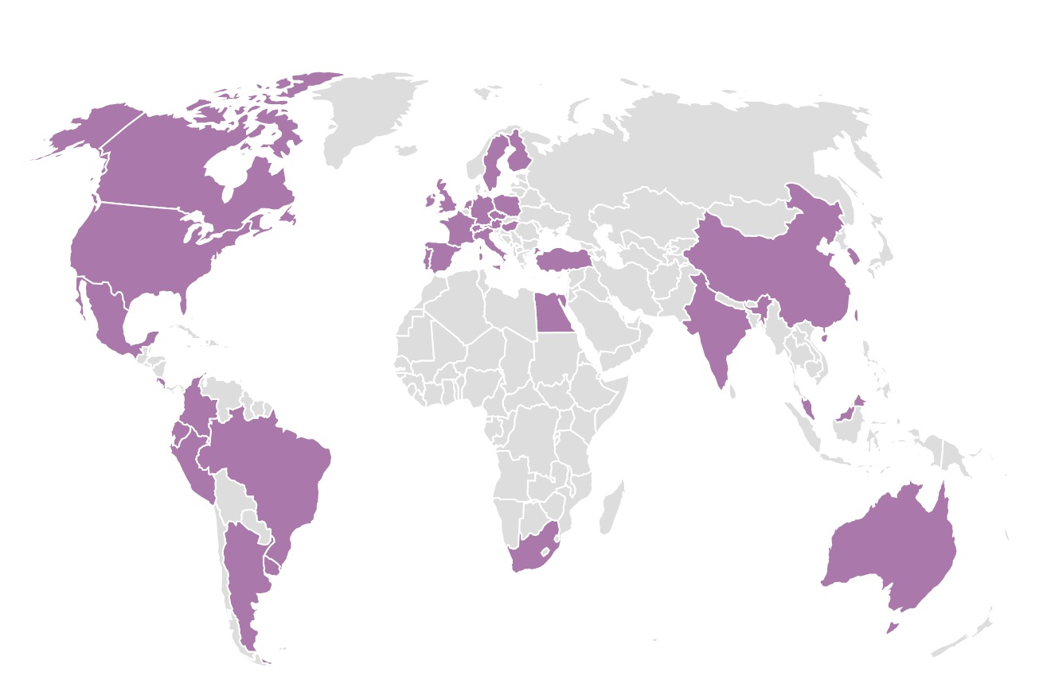
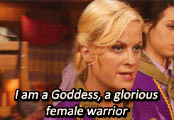
R-Ladies
https://rladies.org/
Notes:
R-ladies is a world-wide organization to promote gender diversity in the r community.
Its an amazing organization of inclusive and genuine people. And there a number of R-Ladies (and founder Gabriela!!!) on the speaker panel today!

Slide 22
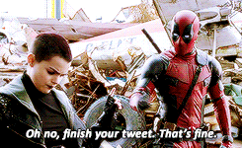
#rstats
https://twitter.com/hashtag/rstats
Notes:
The impact of the twitter R community! Sometimes social media can be a drain however, when anyone new to the community ask about how they can learn about events, solicit help I always point them to using the #rstats hashtag for a method of connection to other R Programmers.

Slide 23

R-Bloggers or RWeekly
https://www.r-bloggers.com/
https://rweekly.org/
Notes:
R-Bloggers (https://www.r-bloggers.com/) and RWeekly (https://rweekly.org/) are nice aggregators so you don’t sweat keeping up with tons of blogs
Blogging is live artifacts for sharing - paraphrasing from David Robinson (@drob) who is also speaking this afternoon, if you have some cool R analyses on your local computer, is essentially useless compared to anything else in the world (blog posts, papers, open source code, tweets even)

Slide 24

rOpenSci
https://ropensci.org/
Notes:
rOpenSci builds software with a community of users and developers, and help to educate scientists about transparent research practices including: hosting a annual unconference, packages review and community support with open calls - many ways in being advocates for the R community.
https://ropensci.org/

Slide 25

R is good for…
Notes:
Wrapping things up with a recap…I tried to hammer across several points about R being versatile in domain application, a fully planned environment alongside the language and R being welcoming and inclusive. I would say that makes R good for..

Slide 26
EVERYTHING

Slide 27


Slide 28
Questions?

